Slide 1



Hello
YOURSTOCK
Buy the rumor,
Sell the news

Slide 2






Introduce ourselves
PROJECT MEMBERS
Mohamed Magdy
Ahmed El Sayed
Omar Adel
Omar Ahmed
Abdelrahman Hussein
Abdelrahman Ezzat

Slide 3

Problem definition
PROBLEM STATEMENT
Trading in equities is not at all easy. The problem centered around the challenges that investors and traders face in making informed decisions about buying, selling, or holding stocks.

Slide 4



Purpose
WHAT IS THE BENEFIT
of YourStock?
Helps investors make informed decisions.
Enables traders to make profits.

Slide 5
Goals
OBJECTIVES
Support retail investors and traders with real time streaming data , charts and news.
Help traders in decision making using latest machine learning technologies.

Slide 6

Who are they?
Individual Investors.
Active Traders.
TARGET AUDIENCE

Slide 7
Planning
PLANNING

Slide 8


Planning
Real-time market data.
Customizable watchlist.
News and insights.
Price prediction
User's data saved on cloud
Secure data.
FEATURES

Slide 9
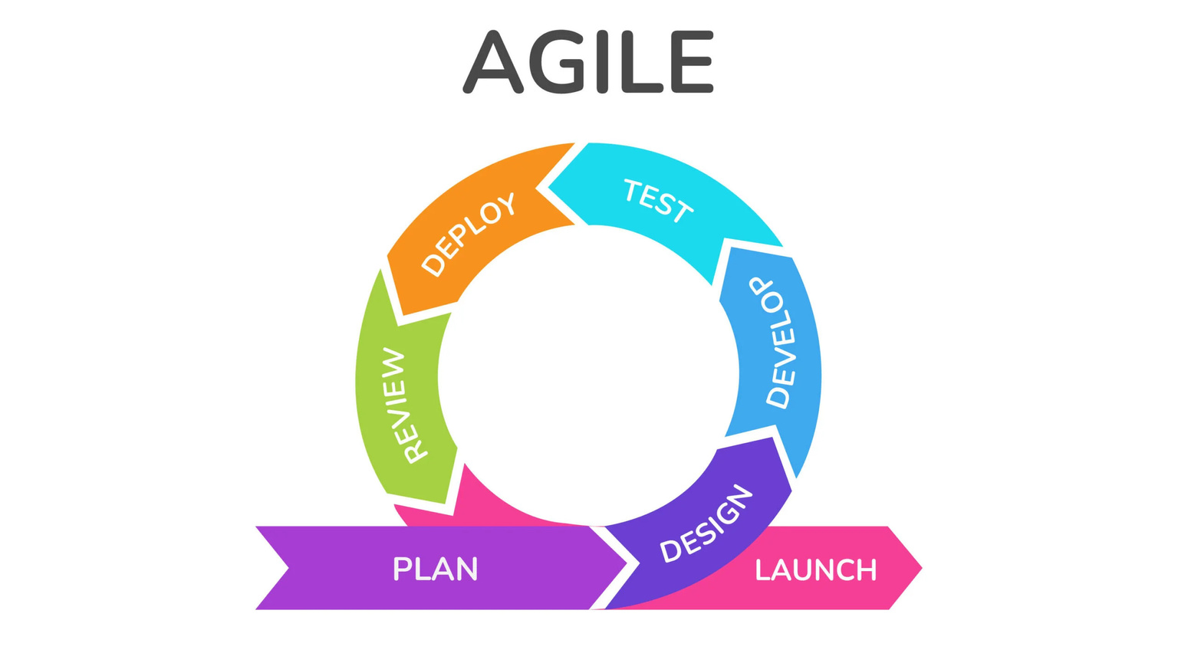
Planning
SYSTEM DEVELOPMENT LIVE CYCLE
Agile

Slide 10

Timeline
ACTION PLAN
Project Timeline
Planning
Dec-Jan
Development
& Testing
March - June
Designing
Jan - March

Slide 11
Designing
UI/UX

Slide 12
Implementation
DEVELOPMENT

Slide 13
Implementation
MACHINE LEARNING
Gradient Boosting
machine learning technique that involves combining multiple weak models to create a strong predictive model.

Slide 14
Implementation
ACCURACY TECHNIQUES
Techniques used to improve the accuracy of the predictions
Grid search

Slide 15

Implementation
PERFORMANCE
ML model run on cloud
Separate refreshing widgets

Slide 16

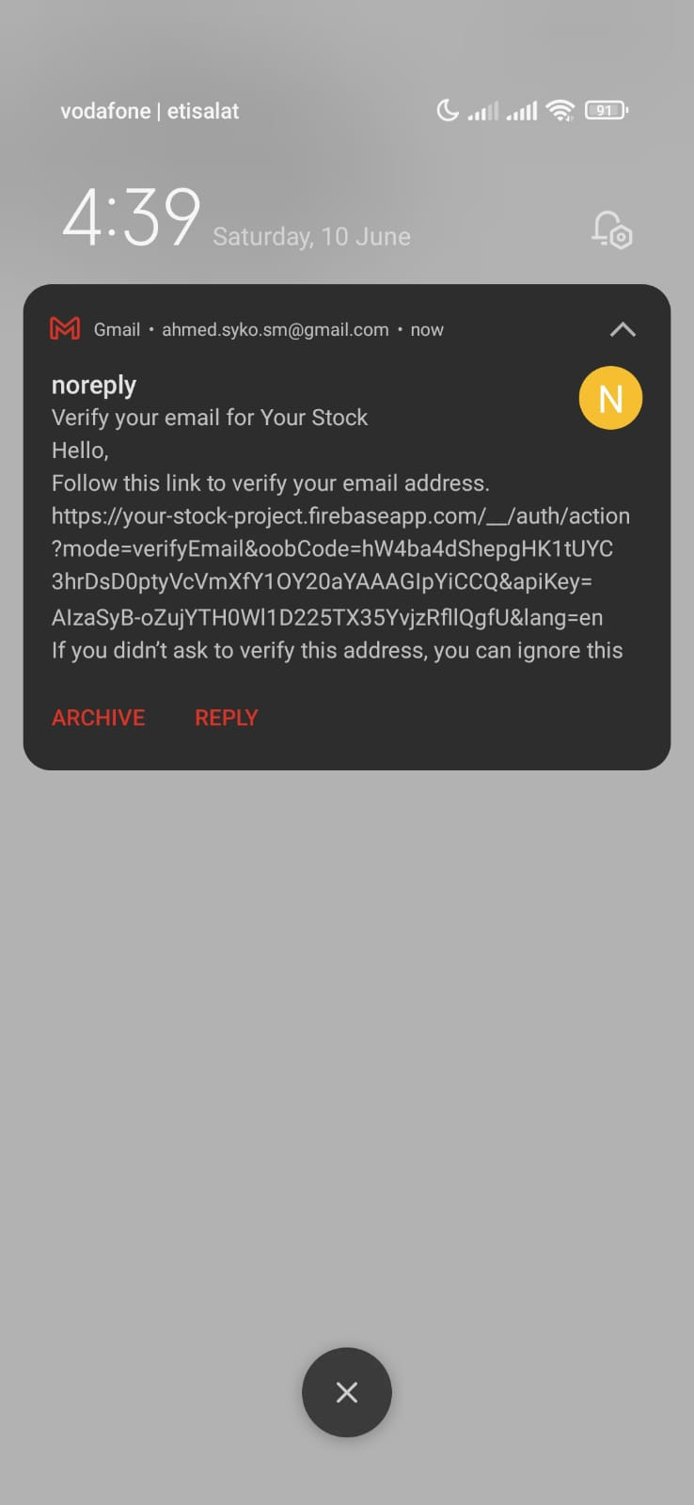
Implementation
Security features
SECURITY
01
Strong passwords
02
Email verification
03
Avoiding sharing sensitive information

Slide 17
Implementation
USER'S DATA
User's data on cloud.
User can access his data from any device.
Watchlist functions.

Slide 18
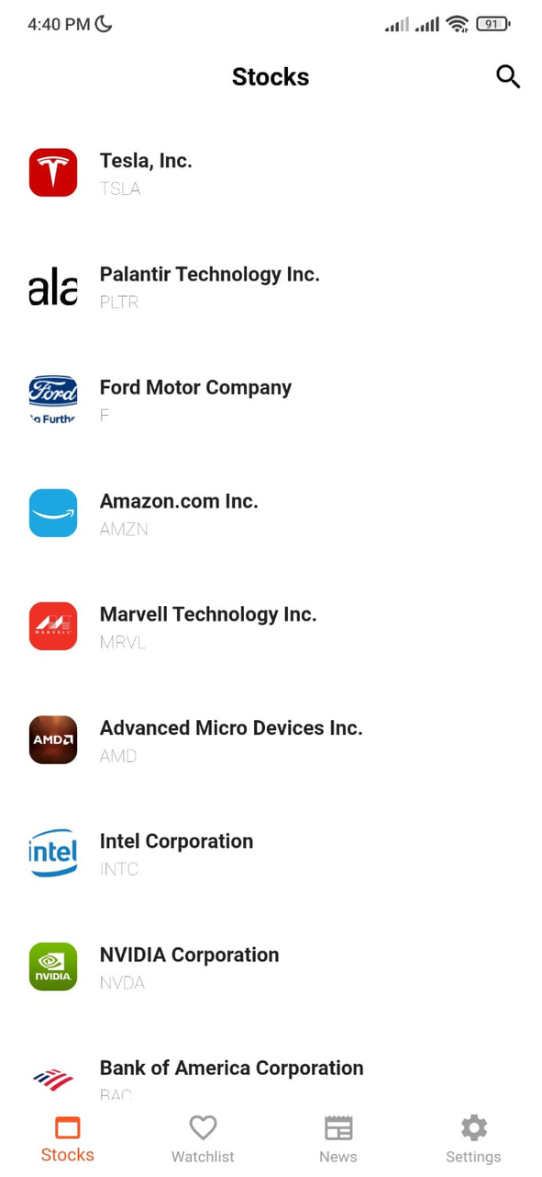
Designing
CORE FEATURES
Home Page
Here shows suggested stocks to user

Slide 19
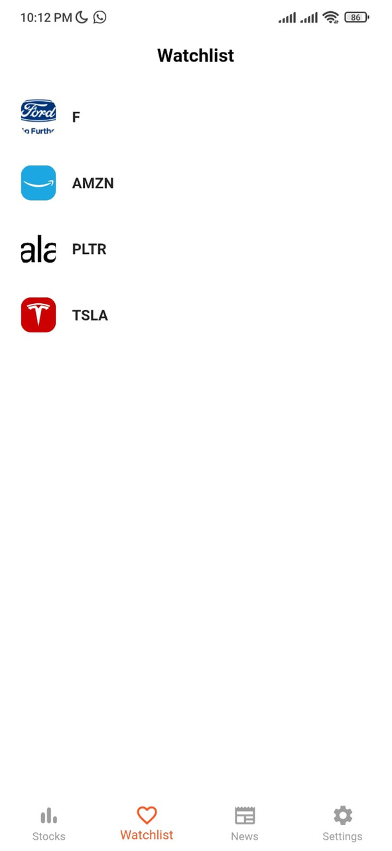
Designing
CORE FEATURES
Watchlist Page
Here shows stocks that user added to his Watchlist

Slide 20
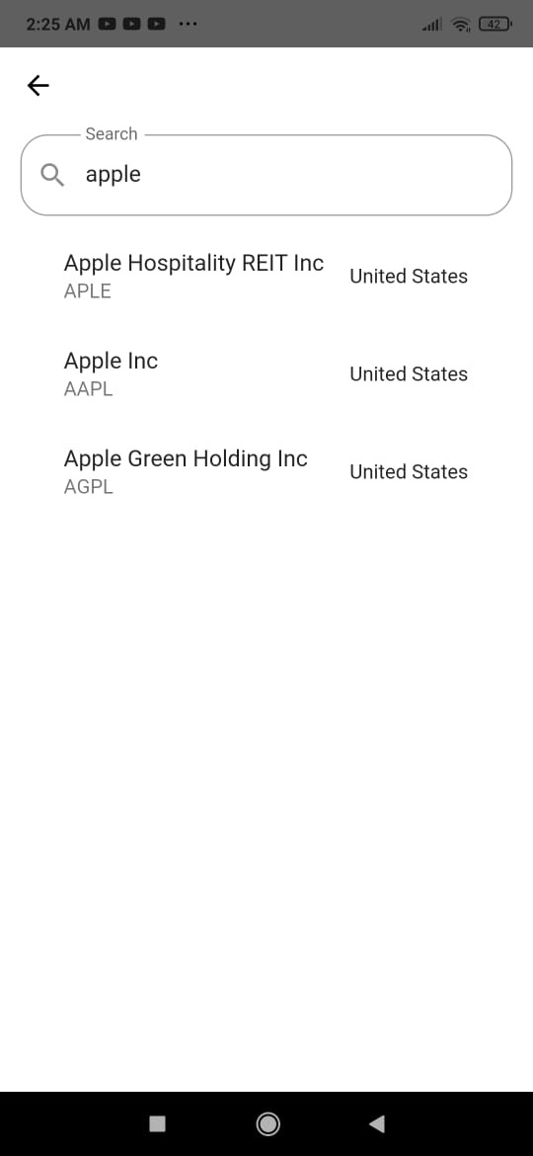
Designing
CORE FEATURES
Search Page
Here shows user can search stocks by name
or ticker

Slide 21
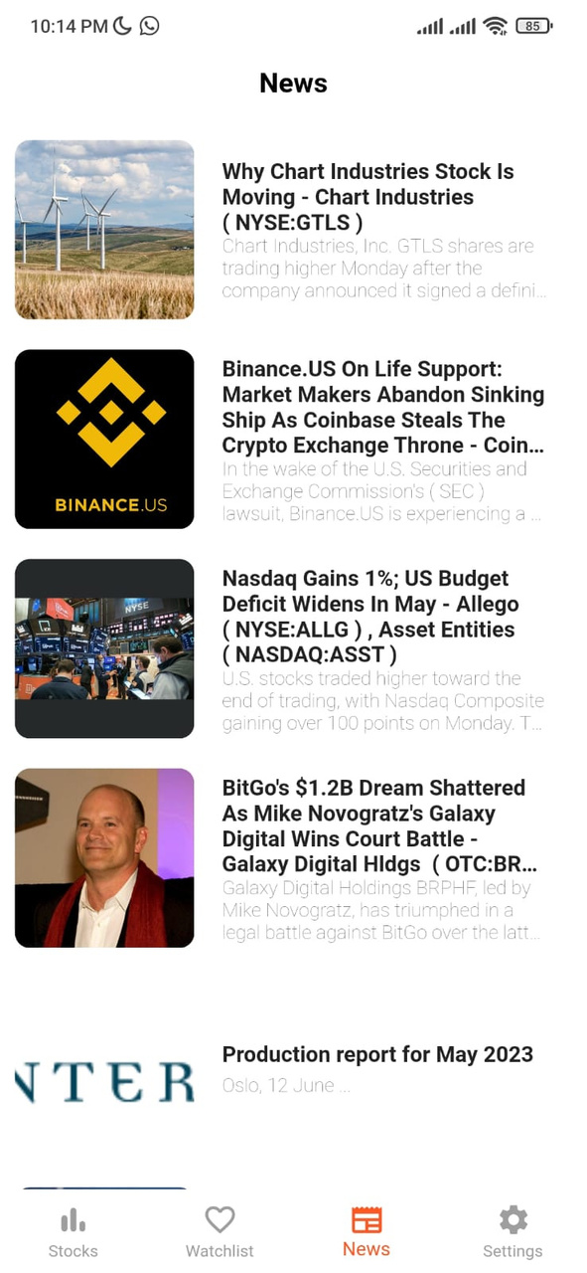
Designing
CORE FEATURES
News Page
Here shows the stock news

Slide 22
references
DATA SOURCES
Stocks logos
API
https://kaggle.com
https://www.alphavantage.co

Slide 23
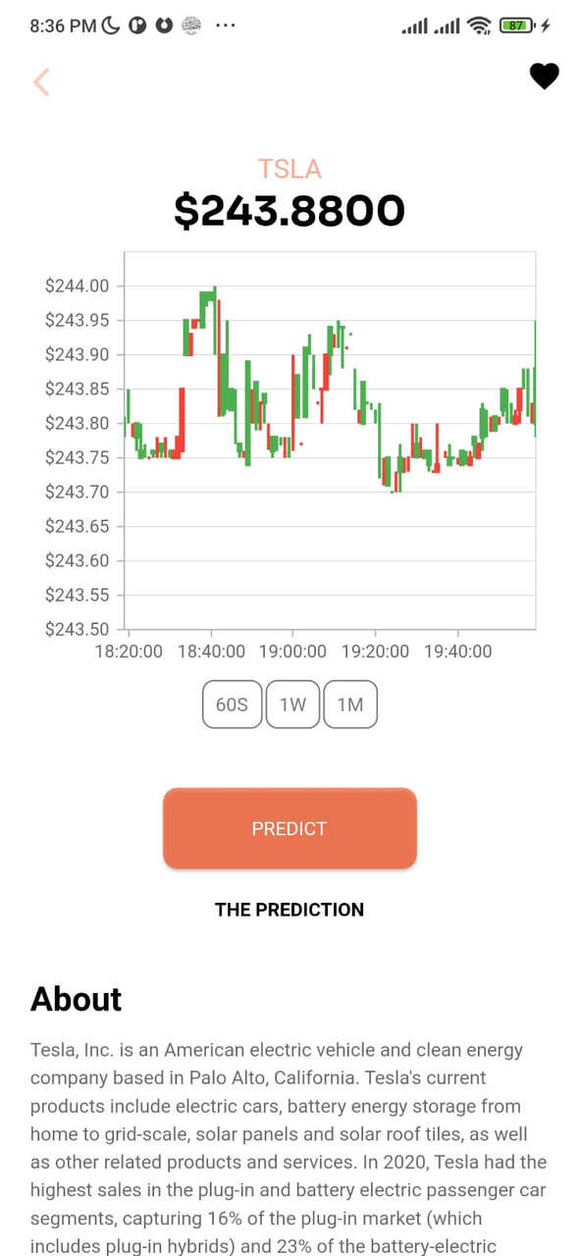
Designing
CORE FEATURES
Stock view page
Here shows detailed information and chart about the stock

Slide 24
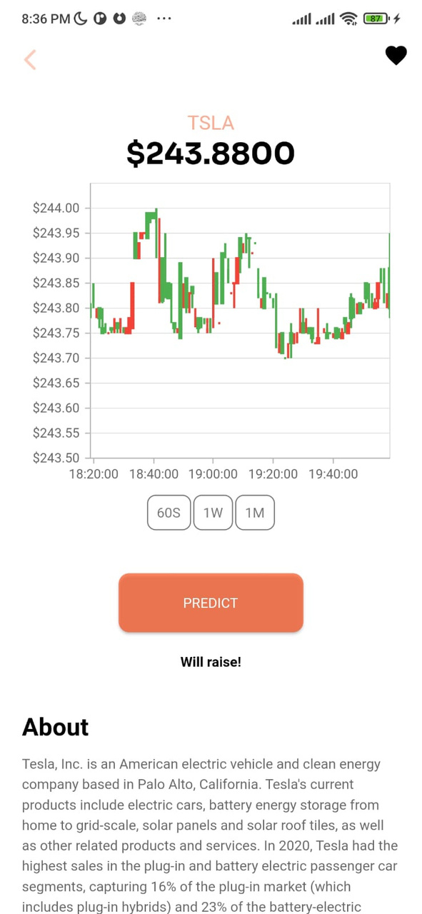
Designing
CORE FEATURES
Stock view page
Here shows when you click on PREDICT button the prediction of the machine learning model will appear

Slide 25
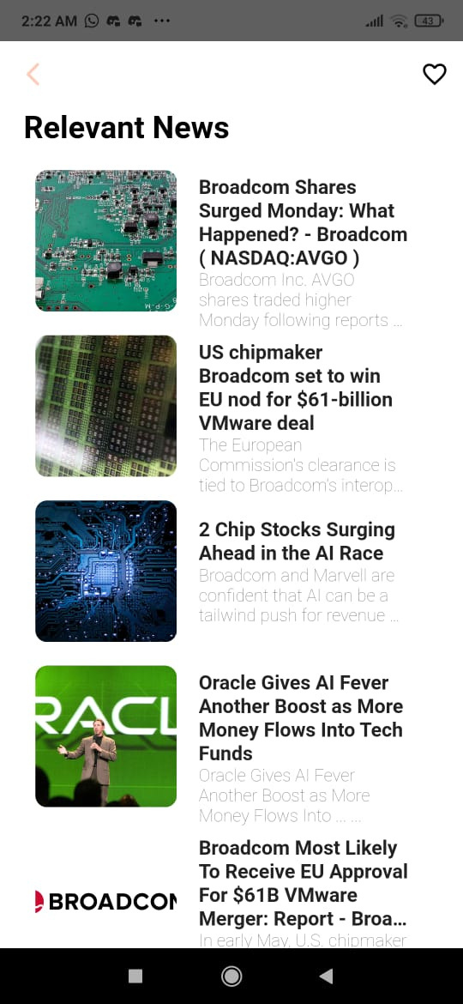
Designing
CORE FEATURES
Stock view page
Here shows some relevant news related to a specific stock.

Slide 26

Business model
REVENUE MODEL
Commission-based model
Freemium model

Slide 27

Plans
FUTURE PLAN
Demo account
Recommended stocks
Push notification to the user if one of his/her stock changes it's price.

Slide 28
Presentation tool used:
https://canva.com
https://support.microsoft.com/
Demo video link:
REFERENCES
https://drive.google.com/drive/folders/1SqNXyg0yRQ5XgwRgUALgr037Z2wdRicC

Slide 29
Thanks..
THANK YOU,
QUESTIONS?

